Slide 1

Silent Speaker
A Lip-reading Model Using Deep Learning
Mid Presentation

Slide 2

Group Members
01
Faria Karim Porna
ID : 1620424042
02
Nazmul Hauqe
ID : 1530862642
03
Md. Sazzad Hossain Bhuiyan
ID : 1521643042.
04
Hira
ID : 1522085642.

Slide 3

Introduction
Lip-reading is the task of decoding text from the movement of a speaker’s mouth.
Studies have shown that human lip-reading performance increases for longer words.
Motivated by this observation, we will build a model that maps a variable-length sequence of video frames to text by using sentence-level sequence prediction.

Slide 4
Why is lip-reading?
It will help deaf people as a hearing aid.
It will help others to recognize the speech of mute people.
It will also help to detect criminals in the detective branch.
It can be used for security purposes.
It can be used for video captioning.
This model will help to recognize speech in noisy areas.
It can be used in silent-movie processing.
It will help to detect fake video.

Slide 5

Literature Reviews

Slide 6
Paper’s Name - Lip-reading via a DNN-HMM hybrid system using combination of the image-based and model-based features
Data Set | CUAVE
Visual feature | The simple raw gray level information of the lips Region of Interest (ROI) The geometric representation of lips shape and The Deep Bottle-neck Features (DBNFs)
Recognition System | The conventional GMM-HMM and The state-of-the-art DNN-HMM hybrid model

Slide 7
Why this features have been used?
Raw Gray Level ROI Features ROI convert the matrix of grayscale images to a 1000×1 vector.
Lips Shape Features
The Active Shape Model (ASM) approach is employed to locate landmarks on speaker’s lips, using STASM library. In order to make the feature vector, the coordinates of all the lips inner and outer landmarks must be concatenated. Furthermore, the height and width of the lips are evaluated and added to the feature vector.

Slide 8
Paper’s Name - Lip Reading in the Wild
They show that CNN architectures can be used to classify temporal sequences with excellent results. On the 333-word test set, they achieved top-1 accuracy of 65.4%, which exceeds state-of-the-art on multiple datasets that have lexicon sizes that are orders of magnitude smaller, and a top-10 accuracy of 92.3%.They also demonstrate a recognition performance that exceeds the state of the art on a standard public benchmark dataset, Oulu VS. Next steps include extending to lip reading of proﬁle views, and combining the CNNs pre-trained using this approach with LSTMs trained with a language model in order to recognize sentences rather than individual words. Of course, the visual only speech recognition method developed here can also be combined with audio only speech recognition to both their beneﬁts.

Slide 9
Papers Name - Thai Lip-Reading CAI for Hearing Impairment Student
They developed the CAI application that is used as a lip reading learning tool for hearing impaired student. Structure of this CAI consist of learning lesson unit and game unit. For The learning lesson unit, student will learn to understand mouth movement of each vocabulary that use in daily life. They can practice and compare their mouth shape with example mouth model. For the game unit, student plays the multiple-choice game to select the correct answer of the question. They conducted an experiment to test if the CAI can help and serve as a learning platform. The result is measured from effectiveness. The test for effectiveness showed positive results. From the pre-test and post-test process, all student scored are more after learning the CAI. Experiment data showed that the number of correct answer increased. In addition, the feedback after CAI using, the students attend to learn and would like to play the game. Therefore, these results indicated that CAI could help students to learn in lip-reading.

Slide 10
Paper’s name - LCANet: End-to-End Lipreading with Cascaded Attention-CTC
Data Set | GRID corpus
Models | LCANet Connectionist Temporal Classification (CTC) The attention-based sequence to sequence(seq2seq) model Markov models (HMMs)
Approach | The mouth regions are cropped from the input video frames from aligned faces. An encoder extracts spatiotemporal features from the input sequence. The cascaded attention-CTC decoder generates text from encoded hidden features.

Slide 11
Paper’s Name - END-TO-END VISUAL SPEECH RECOGNITION WITH LSTMS.
In this paper, they have presented an end-to-end visual speech recognition system which jointly learns to extract features directly from the pixels and perform classiﬁcation using LSTM networks. Results on subject independent experiments demonstrate that the proposed model achieves state-of-the-art performance on the OuluVS2 and CUAVE databases when compared with models which use a similar visual front end.

Slide 12
Paper’s Name - End-to-End Multi-View Lip-reading
In this work, they have presented an end-to-end multi-view lip reading system which jointly learns to extract features directly from the pixels and performs classification using BLSTM networks. The proposed model achieves state-of-the-art performance on the OuluVS2 without using external data for training or even data augmentation. The provided mouth ROIs are well cropped and this might not be the case when automatic tools for mouth ROI detection are used. The model can be easily extended to multiple streams so they added an audio stream in order to evaluate its performance on audiovisual multi-view speech recognition.

Slide 13
Paper’s Name - SPEAKER IDENTIFICATION BY LIPREADING
In this paper, a novel approach fix speaker identification has been described on ca spatial and temporal analysis of the mouth. Facial features are extracted from image sequences which represent the shape and intensity of the lips. The features are of low dimension and invariant to scale, translation and rotation. considering the small training and test duration. results are encouraging and demonstrate that lip intonation is an important cue for person. Further experiments are necessary to evaluate the performance of the method for a large number of subjects and to investigate the benefit of combining it with other approaches like speaker recognition and fact recognition.

Slide 14
Paper’s Name - A real-time lip localization and tacking for lip reading
In this paper, they described a new robust approach to improve lip localization and tracking. The first part of their proposed algorithm is lip location based on OpenCV. From experimental results, their proposed method can successfully detect the lip region. Results from the lip location accuracy allowed more accurate lip region segmentation. In the second part, a new method called a component of Lab color space is proposed to accurately extract lip shape and track lip region. Overall, their implemented approach has shown high reliability and is able to perform robustly under various conditions.

Slide 15
Paper’s Name - Lip localization technique towards an automatic lip reading approach for Myanmar consonants recognition
This paper, proposed the technique to localize lip region for the Myanmar consonants recognition. The experimental system demonstrates that this technique performs lip motion sequences in video. In their experiment, they have localized all of the test lip movement successfully and the results were perceived to be acceptable for lip reading. For future work, they would intend to explore more observable features and recognition phase by applying Support Vector Machine classifier (SVM) method for remaining three syllable and four syllable Myanmar consonants recognition based on lip movements to produce the good recognition result.

Slide 16
Paper’s Name - Geometry Based Lip Reading System Using Multi Dimension Dynamic Time warping
Data Set | CUAVE
Model | Separate classification Dynamic Time warping(DTW) Multi- Dimensional DTW
Accuracy | 72%

Slide 17
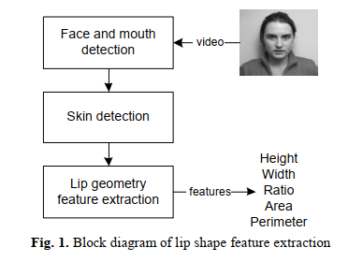
LIP GEOMETRY FEATURE EXTRACTION USING SKIN COLOR FILTER, BORDER FOLLOWING AND CONVEX HULL
Main purpose of the thesis paper

Slide 18
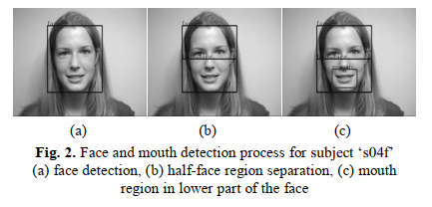
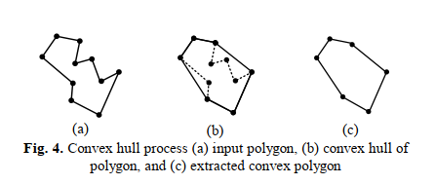
Face and Mouth Detection
A wide range of techniques are available for extracting the face and mouth region, such as template matching and motion detection. Here first detect a mouth and split it into two part because lip always in lower part of the mouth and also a reason to avoid the risk of false detection that can arise from the inadvertent classification of an eye as a mouth .
Lip Geometry feature extraction
The segmented image containing the lip region is then converted to a binary format and contour extraction using border following is applied. When they wanted to represent the binary part into graph then that will be a poor representation because there will be a polyline without many intercepting portion to join all intercept and make a largest shape need to apply convex hull process.

Slide 19
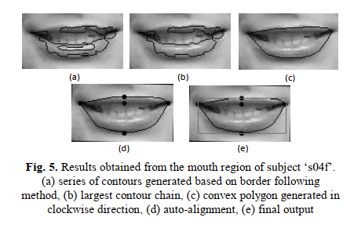
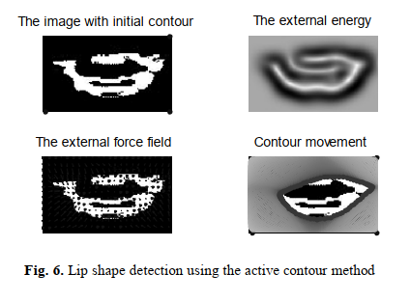
With applying border following and convex hull they have found a proper shape of a lip
Comparison with state of the art
In Fig. 6 using the binary lip image as input, it shows that the active contour technique was unable to convergence to a suitable lip shape despite using a wide range of parameters. The failure to converge is due to the external energy generated not being clearly confined within the region of the mouth. A further drawback of the active contour method is the time it takes to convergence compared to the convex hull approach and the fact that the termination of the algorithm is highly dependent on the criteria set during evaluation.

Slide 20
Paper’s Name - LipNet: End-to-End Sentence-level Lip reading
Data Set | GRID corpus (1000 sentences by 34 talkers (18 male, 16 female)
Model | Spatiotemporal Convolutional Neural Network (ST-CNN) Bi-directional Gated Recurrent Unit Connectionist Temporal Classification (CTC)
Accuracy | 95.2%

Slide 21
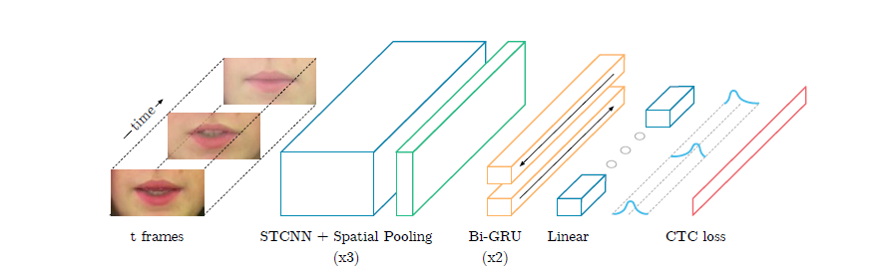
Paper’s Name - LipNet: End-to-End Sentence-level Lip reading

Slide 22
Paper’s Name - LipNet: End-to-End Sentence-level Lipreading
Spatiotemporal Convolutional Neural Network : ST-CNN is used for extracting feature for spatio-temporal data.
Bi-directional GRU : It is used as sequential model because bi directional GRU model can predict the current word in a sentence based on both the previous and later data.
Connectionist Temporal Classification : It is a operation to tackle sequence problems where timing is variable. It assigns the character with the highest probability (or no character) to every input sequence.

Slide 23
What Difference We Will Make
We will use more data so that our model can be trained well.
We will try to generate dataset using different angles.
The previous works done by others have mostly used front faced dataset. Here we will make change. We will also use the dataset where speaker can move face while speaking but the model still can track the lip position accurately.
Some of the related works are speaker-dependent here we will try to build model based on speaker-independency.

Slide 24
Work Done So Far
We have read several related papers to get more idea about the whole project.
We have collected required dataset for the model.
We are reproducing the existing related code.
We have trained the dataset based on several optimizers like RMSprop, Adam etc.

Slide 25
Lets go to the coding part….

Slide 26
Goal
We will complete the reproduction of the existing project.
We will generate more dataset.
We will use our build model in application level.

Slide 27

Thank You

